Slide 1
Results from top Classifiers

Slide 2
Approach
8 different classifiers of mutations each with 3 different value parameters:
Actual / Expected 5, 7.5, and 10. 5 was out starting ratio then we moved to 10. 7.5 is the middle of the two.
FP <= 0, 1, and 2. These count from zero.
P value < 0.05, 0.01, and 0.005, these have all been threshold we have looked at in the past.
Chi squared > 3.84, 7.68, 15.36, This is doubled each time from 3.84 which is the minimum requirement.
TP-2*FP > 2, 3, and 4. Starting from our beginning threshold 2 and incrementing by 1.
TP>X and FP = 0 where X is 2, 4 or 6. Our best preforming forest from before was TP>4 and FP=0 so I used two below and above to test performance.
Random forests Gini importance > 0.01, 0.001, and 0. These mutations come from the three top preforming forests from the previous forest’s generations.
The union of the other 7 sets. The first union is of all the strictest thresholds, the second is the middle thresholds and the last is the loosest thresholds for all three.
As an example, the strictest union is FP <= 0, P value < 0.005, Chi squared > 15.36, TP-2*FP > 4, TP > 6 FP = 0, and Gini importance > 0.01
The number of trees in a forest can be 50, 100, 500, 1000, 5000, or 10000
This gives a total combination amount of 144 parameter groups (8 * 3 * 6)
Each forest uses 10-fold cross validation (1440 total forests)
Each forest uses Entropy to split nodes
Foreground is CIMP+ and Background is CIMP-
Test size is 1/ #folds and training is 1 - 1 / #folds (10% and 90% respectively)

Slide 3
Overall Statistics
Seperator Type | Threshold | Tree Amount | Included Muts | TP | FP | FN | TN | Accuracy | Sensitivity | Specificity | Precision | Miss Rate | False discovery rate | False omission rate
CHISquared | 3.84 | 500 | 739 | 8.2 | 0.7 | 2 | 14.1 | 0.892 | 0.815404 | 0.952321 | 0.924603 | 0.184596 | 0.075397 | 0.120237
PValue | 0.005 | 50 | 147 | 6.9 | 0.4 | 2.8 | 14.9 | 0.872 | 0.719177 | 0.975521 | 0.944444 | 0.280823 | 0.055556 | 0.156031
AE | 10 | 500 | 175 | 6.6 | 0 | 3.7 | 14.7 | 0.852 | 0.637097 | 1 | 1 | 0.362903 | 0 | 0.206255
Union | 0 | 500 | 857 | 7.1 | 0.5 | 3.3 | 14.1 | 0.848 | 0.687683 | 0.965521 | 0.932652 | 0.312317 | 0.067348 | 0.196521
TP-2FP | 2 | 100 | 609 | 6.2 | 0 | 3.9 | 14.9 | 0.844 | 0.60246 | 1 | 1 | 0.39754 | 0 | 0.20396
Forest | 0.001 | 1000 | 463 | 7.2 | 0.8 | 3.4 | 13.6 | 0.832 | 0.687988 | 0.945046 | 0.903611 | 0.312012 | 0.096389 | 0.198481
FP | 0 | 10000 | 556 | 5.4 | 0 | 4.4 | 15.2 | 0.824 | 0.57735 | 1 | 1 | 0.42265 | 0 | 0.217927

Slide 4
CHI Squared
Seperator Type | Threshold | Tree Amount | Three-Fold Run | TP | FP | FN | TN | Accuracy | Sensitivity | Specificity | Precision | Miss Rate | False discovery rate | False omission rate | Included Muts
CHISquared | 3.84 | 500 | 0 | 8 | 0 | 2 | 15 | 0.92 | 0.8 | 1 | 1 | 0.2 | 0 | 0.117647 | 739
CHISquared | 3.84 | 500 | 1 | 9 | 1 | 2 | 13 | 0.88 | 0.818182 | 0.928571 | 0.9 | 0.181818 | 0.1 | 0.133333 | 739
CHISquared | 3.84 | 500 | 2 | 9 | 0 | 0 | 16 | 1 | 1 | 1 | 1 | 0 | 0 | 0 | 739
CHISquared | 3.84 | 500 | 3 | 8 | 1 | 1 | 15 | 0.92 | 0.888889 | 0.9375 | 0.888889 | 0.111111 | 0.111111 | 0.0625 | 739
CHISquared | 3.84 | 500 | 4 | 7 | 0 | 5 | 13 | 0.8 | 0.583333 | 1 | 1 | 0.416667 | 0 | 0.277778 | 739
CHISquared | 3.84 | 500 | 5 | 9 | 1 | 1 | 14 | 0.92 | 0.9 | 0.933333 | 0.9 | 0.1 | 0.1 | 0.066667 | 739
CHISquared | 3.84 | 500 | 6 | 8 | 2 | 2 | 13 | 0.84 | 0.8 | 0.866667 | 0.8 | 0.2 | 0.2 | 0.133333 | 739
CHISquared | 3.84 | 500 | 7 | 6 | 1 | 5 | 13 | 0.76 | 0.545455 | 0.928571 | 0.857143 | 0.454545 | 0.142857 | 0.277778 | 739
CHISquared | 3.84 | 500 | 8 | 9 | 1 | 2 | 13 | 0.88 | 0.818182 | 0.928571 | 0.9 | 0.181818 | 0.1 | 0.133333 | 739
CHISquared | 3.84 | 500 | 9 | 9 | 0 | 0 | 16 | 1 | 1 | 1 | 1 | 0 | 0 | 0 | 739
CHISquared | 3.84 | 500 |  | 8.2 | 0.7 | 2 | 14.1 | 0.892 | 0.815404 | 0.952321 | 0.924603 | 0.184596 | 0.075397 | 0.120237 | 739

Slide 5
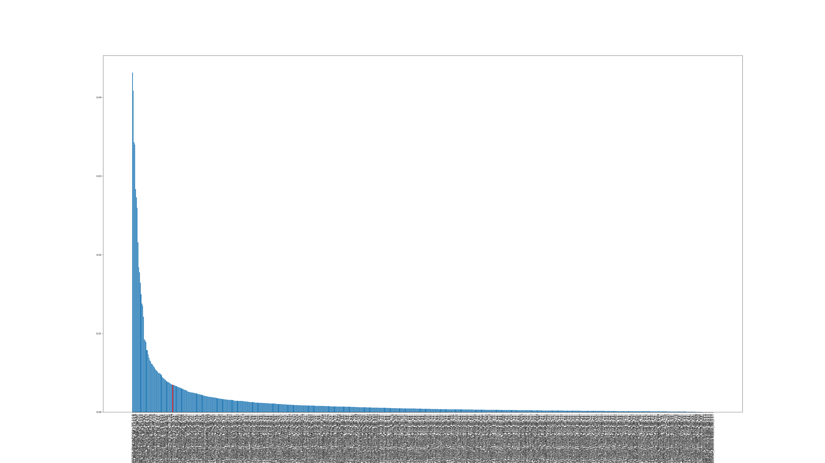
Gini Importance CHI Squared

Slide 6
P Value
Separator Type | Threshold | Tree Amount | Three-Fold Run | TP | FP | FN | TN | Accuracy | Sensitivity | Specificity | Precision | Miss Rate | False discovery rate | False omission rate | Included Muts
PValue | 0.005 | 50 | 0 | 7 | 0 | 4 | 14 | 0.84 | 0.636364 | 1 | 1 | 0.363636 | 0 | 0.222222 | 147
PValue | 0.005 | 50 | 1 | 6 | 0 | 6 | 13 | 0.76 | 0.5 | 1 | 1 | 0.5 | 0 | 0.315789 | 147
PValue | 0.005 | 50 | 2 | 13 | 0 | 1 | 11 | 0.96 | 0.928571 | 1 | 1 | 0.071429 | 0 | 0.083333 | 147
PValue | 0.005 | 50 | 3 | 7 | 0 | 4 | 14 | 0.84 | 0.636364 | 1 | 1 | 0.363636 | 0 | 0.222222 | 147
PValue | 0.005 | 50 | 4 | 5 | 1 | 1 | 18 | 0.92 | 0.833333 | 0.947368 | 0.833333 | 0.166667 | 0.166667 | 0.052632 | 147
PValue | 0.005 | 50 | 5 | 7 | 0 | 1 | 17 | 0.96 | 0.875 | 1 | 1 | 0.125 | 0 | 0.055556 | 147
PValue | 0.005 | 50 | 6 | 6 | 0 | 1 | 18 | 0.96 | 0.857143 | 1 | 1 | 0.142857 | 0 | 0.052632 | 147
PValue | 0.005 | 50 | 7 | 7 | 2 | 3 | 13 | 0.8 | 0.7 | 0.866667 | 0.777778 | 0.3 | 0.222222 | 0.1875 | 147
PValue | 0.005 | 50 | 8 | 5 | 1 | 3 | 16 | 0.84 | 0.625 | 0.941176 | 0.833333 | 0.375 | 0.166667 | 0.157895 | 147
PValue | 0.005 | 50 | 9 | 6 | 0 | 4 | 15 | 0.84 | 0.6 | 1 | 1 | 0.4 | 0 | 0.210526 | 147
PValue | 0.005 | 50 |  | 6.9 | 0.4 | 2.8 | 14.9 | 0.872 | 0.719177 | 0.975521 | 0.944444 | 0.280823 | 0.055556 | 0.156031 | 147

Slide 7
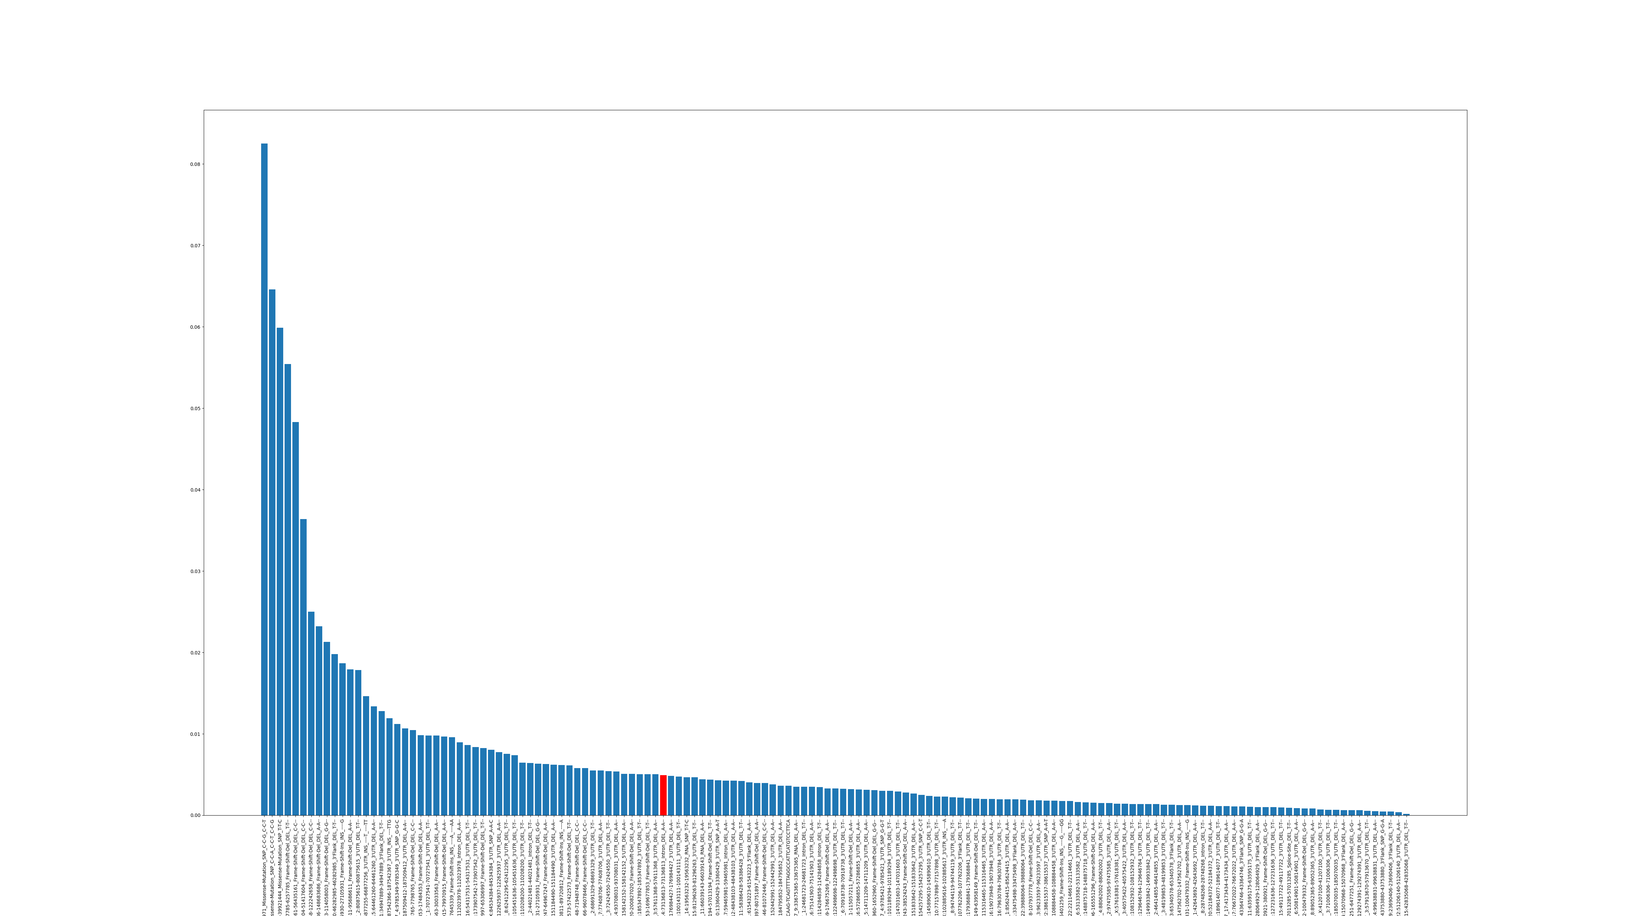
Gini Importance P Value

Slide 8
Actual / Expected ratio
Seperator Type | Threshold | Tree Amount | Three-Fold Run | TP | FP | FN | TN | Accuracy | Sensitivity | Specificity | Precision | Miss Rate | False discovery rate | False omission rate | Included Muts
AE | 10 | 500 | 0 | 5 | 0 | 4 | 16 | 0.84 | 0.555556 | 1 | 1 | 0.444444 | 0 | 0.2 | 175
AE | 10 | 500 | 1 | 9 | 0 | 7 | 9 | 0.72 | 0.5625 | 1 | 1 | 0.4375 | 0 | 0.4375 | 175
AE | 10 | 500 | 2 | 7 | 0 | 3 | 15 | 0.88 | 0.7 | 1 | 1 | 0.3 | 0 | 0.166667 | 175
AE | 10 | 500 | 3 | 9 | 0 | 4 | 12 | 0.84 | 0.692308 | 1 | 1 | 0.307692 | 0 | 0.25 | 175
AE | 10 | 500 | 4 | 6 | 0 | 5 | 14 | 0.8 | 0.545455 | 1 | 1 | 0.454545 | 0 | 0.263158 | 175
AE | 10 | 500 | 5 | 7 | 0 | 4 | 14 | 0.84 | 0.636364 | 1 | 1 | 0.363636 | 0 | 0.222222 | 175
AE | 10 | 500 | 6 | 9 | 0 | 2 | 14 | 0.92 | 0.818182 | 1 | 1 | 0.181818 | 0 | 0.125 | 175
AE | 10 | 500 | 7 | 8 | 0 | 3 | 14 | 0.88 | 0.727273 | 1 | 1 | 0.272727 | 0 | 0.176471 | 175
AE | 10 | 500 | 8 | 4 | 0 | 1 | 20 | 0.96 | 0.8 | 1 | 1 | 0.2 | 0 | 0.047619 | 175
AE | 10 | 500 | 9 | 2 | 0 | 4 | 19 | 0.84 | 0.333333 | 1 | 1 | 0.666667 | 0 | 0.173913 | 175
AE | 10 | 500 |  | 6.6 | 0 | 3.7 | 14.7 | 0.852 | 0.637097 | 1 | 1 | 0.362903 | 0 | 0.206255 | 175

Slide 9
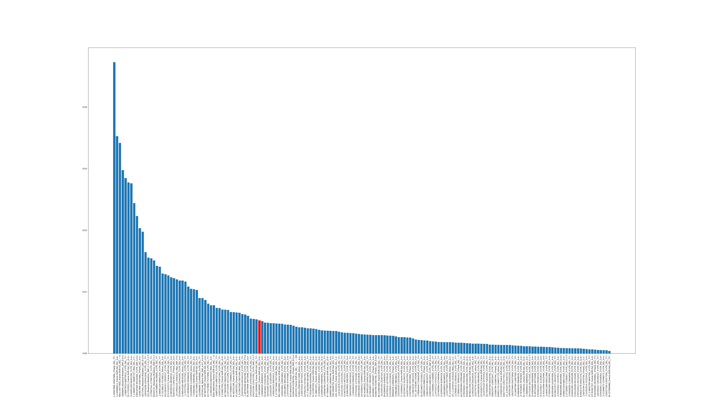
Gini Importance Actual / Expected ratio

Slide 10
Union
Seperator Type | Threshold | Tree Amount | Three-Fold Run | TP | FP | FN | TN | Accuracy | Sensitivity | Specificity | Precision | Miss Rate | False discovery rate | False omission rate | Included Muts
Union | 0 | 500 | 0 | 10 | 0 | 4 | 11 | 0.84 | 0.714286 | 1 | 1 | 0.285714 | 0 | 0.266667 | 857
Union | 0 | 500 | 1 | 7 | 1 | 3 | 14 | 0.84 | 0.7 | 0.933333 | 0.875 | 0.3 | 0.125 | 0.176471 | 857
Union | 0 | 500 | 2 | 9 | 2 | 4 | 10 | 0.76 | 0.692308 | 0.833333 | 0.818182 | 0.307692 | 0.181818 | 0.285714 | 857
Union | 0 | 500 | 3 | 4 | 1 | 2 | 18 | 0.88 | 0.666667 | 0.947368 | 0.8 | 0.333333 | 0.2 | 0.1 | 857
Union | 0 | 500 | 4 | 6 | 0 | 2 | 17 | 0.92 | 0.75 | 1 | 1 | 0.25 | 0 | 0.105263 | 857
Union | 0 | 500 | 5 | 5 | 0 | 2 | 18 | 0.92 | 0.714286 | 1 | 1 | 0.285714 | 0 | 0.1 | 857
Union | 0 | 500 | 6 | 8 | 0 | 2 | 15 | 0.92 | 0.8 | 1 | 1 | 0.2 | 0 | 0.117647 | 857
Union | 0 | 500 | 7 | 10 | 0 | 4 | 11 | 0.84 | 0.714286 | 1 | 1 | 0.285714 | 0 | 0.266667 | 857
Union | 0 | 500 | 8 | 5 | 1 | 3 | 16 | 0.84 | 0.625 | 0.941176 | 0.833333 | 0.375 | 0.166667 | 0.157895 | 857
Union | 0 | 500 | 9 | 7 | 0 | 7 | 11 | 0.72 | 0.5 | 1 | 1 | 0.5 | 0 | 0.388889 | 857
Union | 0 | 500 |  | 7.1 | 0.5 | 3.3 | 14.1 | 0.848 | 0.687683 | 0.965521 | 0.932652 | 0.312317 | 0.067348 | 0.196521 | 857

Slide 11
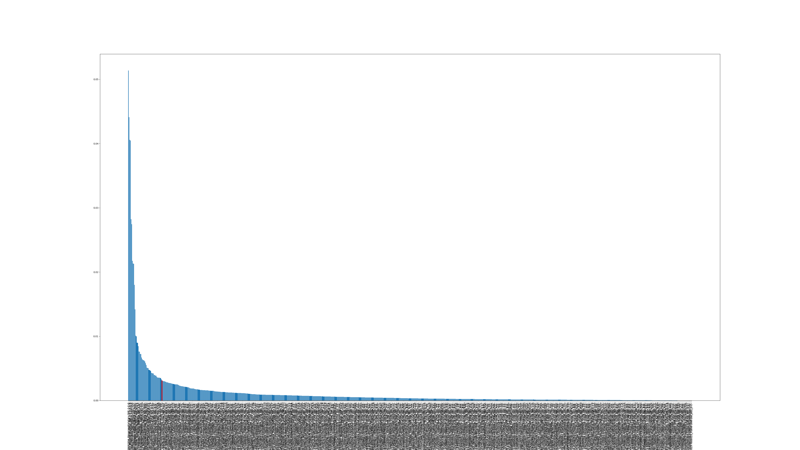
Gini Importance Union

Slide 12
TP – 2FP
Seperator Type | Threshold | Tree Amount | Three-Fold Run | TP | FP | FN | TN | Accuracy | Sensitivity | Specificity | Precision | Miss Rate | False discovery rate | False omission rate | Included Muts
TP-2FP | 2 | 100 | 0 | 8 | 0 | 2 | 15 | 0.92 | 0.8 | 1 | 1 | 0.2 | 0 | 0.117647 | 609
TP-2FP | 2 | 100 | 1 | 6 | 0 | 3 | 16 | 0.88 | 0.666667 | 1 | 1 | 0.333333 | 0 | 0.157895 | 609
TP-2FP | 2 | 100 | 2 | 5 | 0 | 4 | 16 | 0.84 | 0.555556 | 1 | 1 | 0.444444 | 0 | 0.2 | 609
TP-2FP | 2 | 100 | 3 | 5 | 0 | 4 | 16 | 0.84 | 0.555556 | 1 | 1 | 0.444444 | 0 | 0.2 | 609
TP-2FP | 2 | 100 | 4 | 2 | 0 | 7 | 16 | 0.72 | 0.222222 | 1 | 1 | 0.777778 | 0 | 0.304348 | 609
TP-2FP | 2 | 100 | 5 | 5 | 0 | 5 | 15 | 0.8 | 0.5 | 1 | 1 | 0.5 | 0 | 0.25 | 609
TP-2FP | 2 | 100 | 6 | 8 | 0 | 2 | 15 | 0.92 | 0.8 | 1 | 1 | 0.2 | 0 | 0.117647 | 609
TP-2FP | 2 | 100 | 7 | 11 | 0 | 3 | 11 | 0.88 | 0.785714 | 1 | 1 | 0.214286 | 0 | 0.214286 | 609
TP-2FP | 2 | 100 | 8 | 7 | 0 | 5 | 13 | 0.8 | 0.583333 | 1 | 1 | 0.416667 | 0 | 0.277778 | 609
TP-2FP | 2 | 100 | 9 | 5 | 0 | 4 | 16 | 0.84 | 0.555556 | 1 | 1 | 0.444444 | 0 | 0.2 | 609
TP-2FP | 2 | 100 |  | 6.2 | 0 | 3.9 | 14.9 | 0.844 | 0.60246 | 1 | 1 | 0.39754 | 0 | 0.20396 | 609

Slide 13
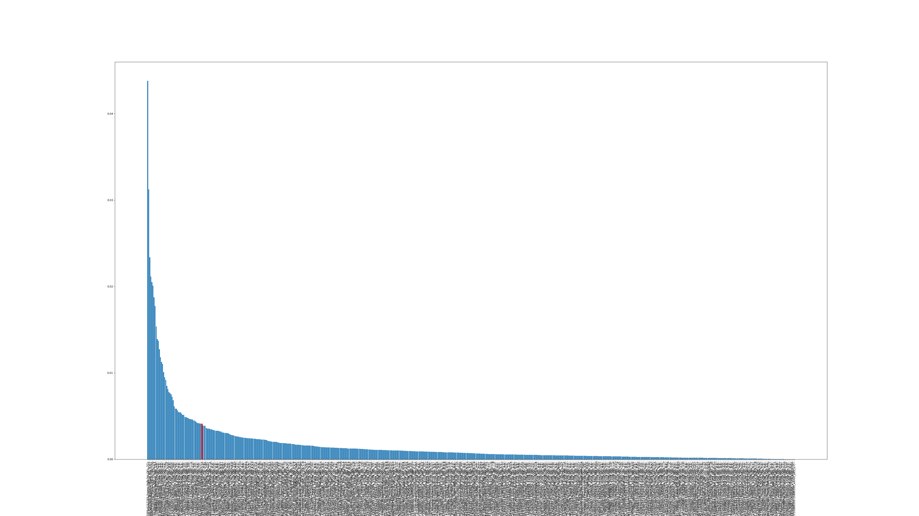
Gini Importance TP – 2FP

Slide 14
Forests
Seperator Type | Threshold | Tree Amount | Three-Fold Run | TP | FP | FN | TN | Accuracy | Sensitivity | Specificity | Precision | Miss Rate | False discovery rate | False omission rate | Included Muts
Forest | 0.001 | 1000 | 0 | 8 | 0 | 4 | 13 | 0.84 | 0.666667 | 1 | 1 | 0.333333 | 0 | 0.235294 | 463
Forest | 0.001 | 1000 | 1 | 5 | 1 | 5 | 14 | 0.76 | 0.5 | 0.933333 | 0.833333 | 0.5 | 0.166667 | 0.263158 | 463
Forest | 0.001 | 1000 | 2 | 7 | 1 | 4 | 13 | 0.8 | 0.636364 | 0.928571 | 0.875 | 0.363636 | 0.125 | 0.235294 | 463
Forest | 0.001 | 1000 | 3 | 7 | 1 | 3 | 14 | 0.84 | 0.7 | 0.933333 | 0.875 | 0.3 | 0.125 | 0.176471 | 463
Forest | 0.001 | 1000 | 4 | 8 | 2 | 3 | 12 | 0.8 | 0.727273 | 0.857143 | 0.8 | 0.272727 | 0.2 | 0.2 | 463
Forest | 0.001 | 1000 | 5 | 8 | 1 | 1 | 15 | 0.92 | 0.888889 | 0.9375 | 0.888889 | 0.111111 | 0.111111 | 0.0625 | 463
Forest | 0.001 | 1000 | 6 | 7 | 0 | 6 | 12 | 0.76 | 0.538462 | 1 | 1 | 0.461538 | 0 | 0.333333 | 463
Forest | 0.001 | 1000 | 7 | 7 | 1 | 2 | 15 | 0.88 | 0.777778 | 0.9375 | 0.875 | 0.222222 | 0.125 | 0.117647 | 463
Forest | 0.001 | 1000 | 8 | 8 | 1 | 4 | 12 | 0.8 | 0.666667 | 0.923077 | 0.888889 | 0.333333 | 0.111111 | 0.25 | 463
Forest | 0.001 | 1000 | 9 | 7 | 0 | 2 | 16 | 0.92 | 0.777778 | 1 | 1 | 0.222222 | 0 | 0.111111 | 463
Forest | 0.001 | 1000 |  | 7.2 | 0.8 | 3.4 | 13.6 | 0.832 | 0.687988 | 0.945046 | 0.903611 | 0.312012 | 0.096389 | 0.198481 | 463

Slide 15
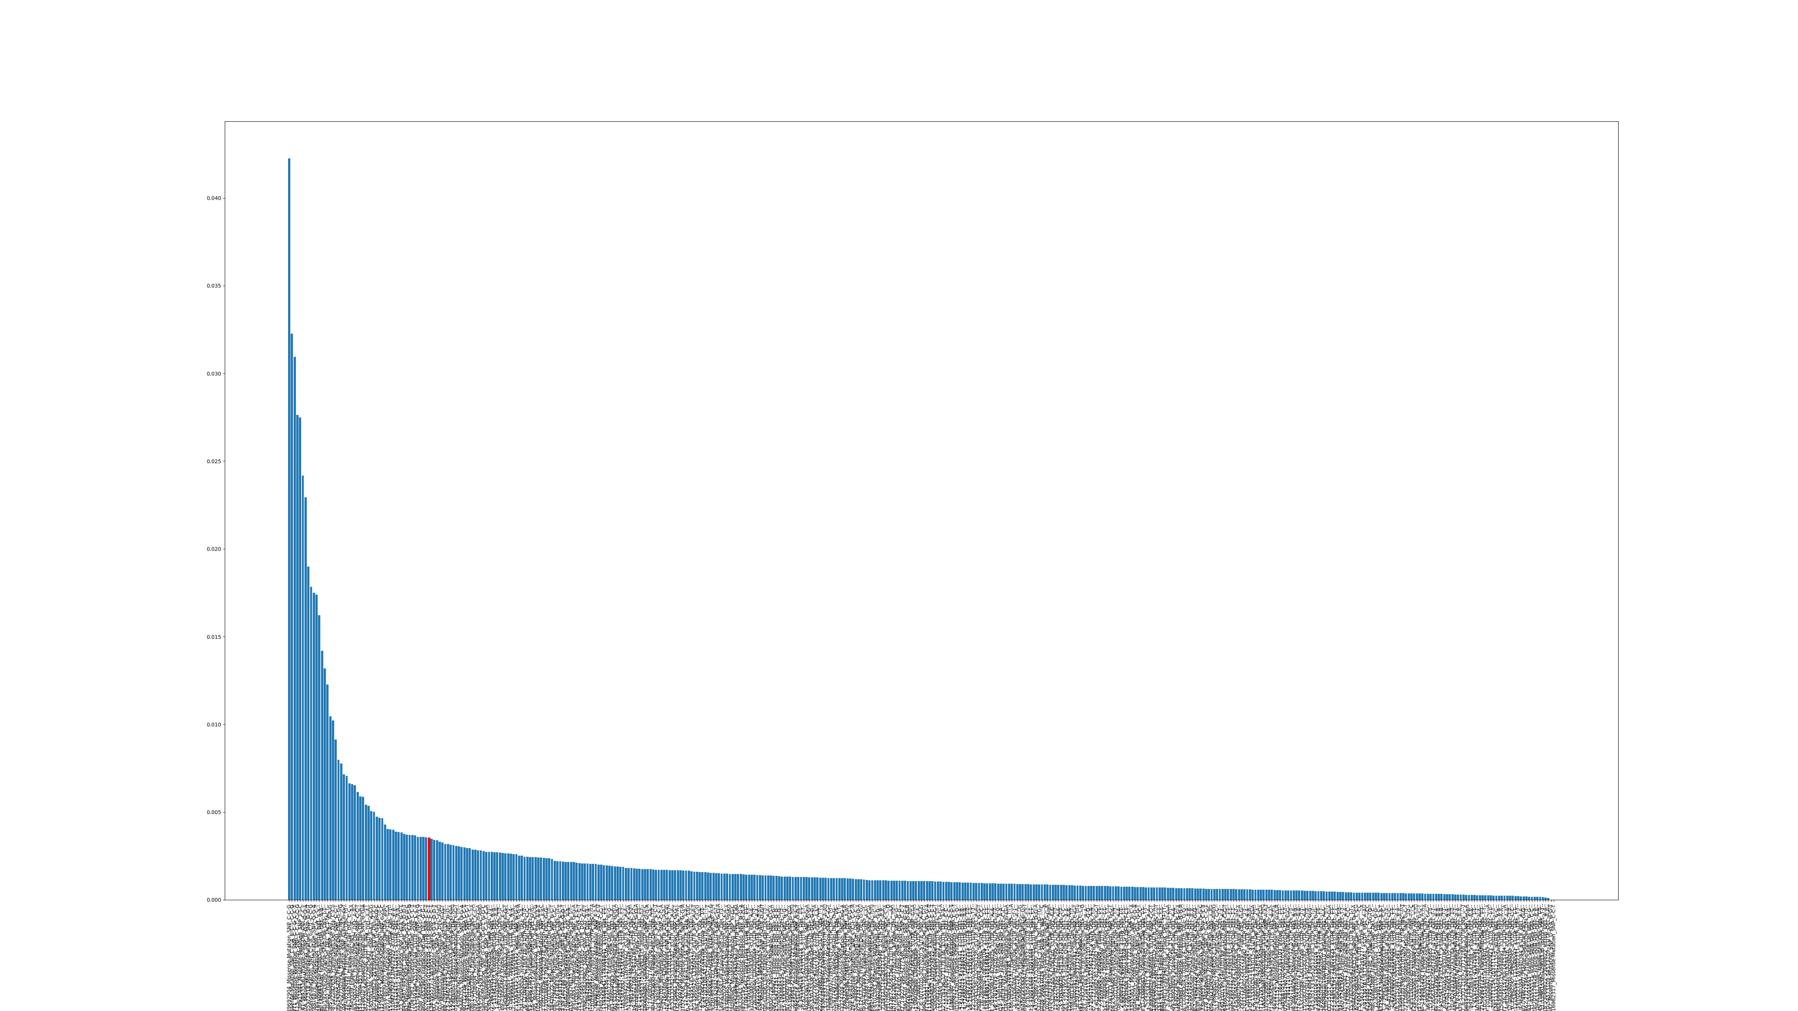
Gini Importance Forests

Slide 16
FP
Seperator Type | Threshold | Tree Amount | Three-Fold Run | TP | FP | FN | TN | Accuracy | Sensitivity | Specificity | Precision | Miss Rate | False discovery rate | False omission rate | Included Muts
FP | 0 | 10000 | 0 | 6 | 0 | 2 | 17 | 0.92 | 0.75 | 1 | 1 | 0.25 | 0 | 0.105263 | 556
FP | 0 | 10000 | 1 | 4 | 0 | 4 | 17 | 0.84 | 0.5 | 1 | 1 | 0.5 | 0 | 0.190476 | 556
FP | 0 | 10000 | 2 | 5 | 0 | 3 | 17 | 0.88 | 0.625 | 1 | 1 | 0.375 | 0 | 0.15 | 556
FP | 0 | 10000 | 3 | 8 | 0 | 1 | 16 | 0.96 | 0.888889 | 1 | 1 | 0.111111 | 0 | 0.058824 | 556
FP | 0 | 10000 | 4 | 3 | 0 | 6 | 16 | 0.76 | 0.333333 | 1 | 1 | 0.666667 | 0 | 0.272727 | 556
FP | 0 | 10000 | 5 | 4 | 0 | 11 | 10 | 0.56 | 0.266667 | 1 | 1 | 0.733333 | 0 | 0.52381 | 556
FP | 0 | 10000 | 6 | 8 | 0 | 2 | 15 | 0.92 | 0.8 | 1 | 1 | 0.2 | 0 | 0.117647 | 556
FP | 0 | 10000 | 7 | 5 | 0 | 3 | 17 | 0.88 | 0.625 | 1 | 1 | 0.375 | 0 | 0.15 | 556
FP | 0 | 10000 | 8 | 5 | 0 | 8 | 12 | 0.68 | 0.384615 | 1 | 1 | 0.615385 | 0 | 0.4 | 556
FP | 0 | 10000 | 9 | 6 | 0 | 4 | 15 | 0.84 | 0.6 | 1 | 1 | 0.4 | 0 | 0.210526 | 556
FP | 0 | 10000 |  | 5.4 | 0 | 4.4 | 15.2 | 0.824 | 0.57735 | 1 | 1 | 0.42265 | 0 | 0.217927 | 556

Slide 17
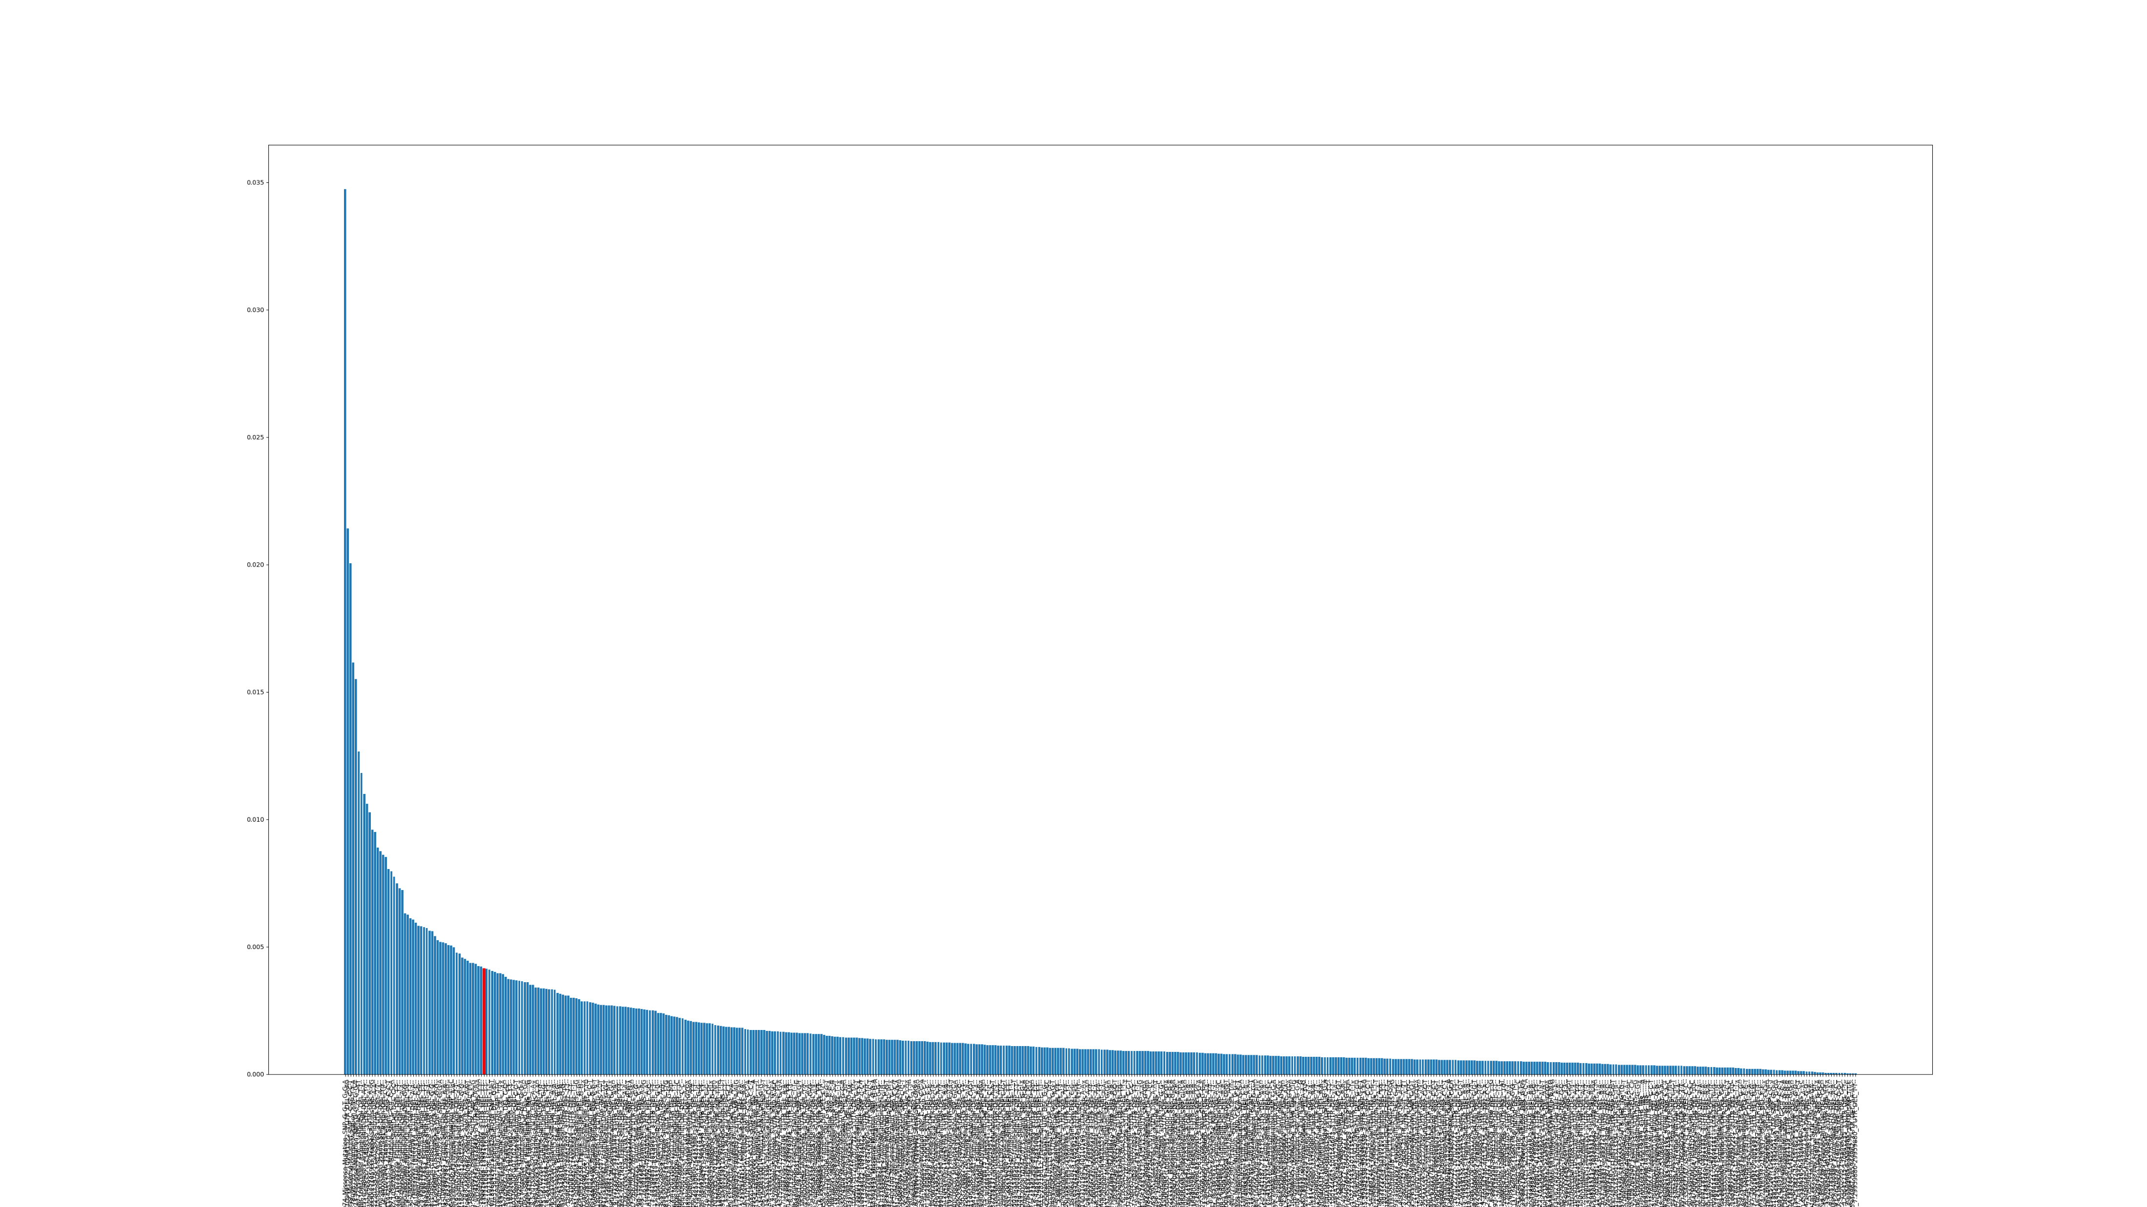
Gini Importance FP

